Slide 1

SRM UNIVERSITY DEPARTMENT OF SOFTWARE ENGINEERING
15CS201J-UNIT 2- ARRAYS AND LISTS

Slide 2
Syllabus
Array implementation of List – Traversing
Insertion – Deletion – Application of List
Linked list – Implementation – Insertion – Deletion and Search
Double linked list
Circular Linked List – Applications – Josephus Problem
Cursor based implementation
Polynomial Arithmetic
Multidimensional Arrays-Sparse Matrix

Slide 3
Outline
Abstract data Type (ADT)
List ADT
List ADT with Array Implementation
Linked lists
Basic operations of linked lists
Insert, find, delete, print, etc.
Variations of linked lists
Circular linked lists
Doubly linked lists

Slide 4
ADT = properties + operations
An ADT describes a set of objects sharing the same properties and behaviors
The properties of an ADT are its data (representing the internal state of each object
double d; -- bits representing exponent & mantissa are its data or state
The behaviors of an ADT are its operations or functions (operations on each instance)
sqrt(d) / 2; //operators & functions are its behaviors

Slide 5
The List ADT
A sequence of zero or more elements
A₁, A₂, A₃, … A_{N}
N: length of the list
A₁: first element
A_{N}: last element
A_{i}: position i
If N=0, then empty list
Linearly ordered
A_{i} precedes A_{i+1}
A_{i} follows A_{i-1}

Slide 6
Operations
printList: print the list
makeEmpty: create an empty list
find: locate the position of an object in a list
list: 34,12, 52, 16, 12
find(52) → 3
insert: insert an object to a list
insert(x,3) → 34, 12, 52, x, 16, 12
remove: delete an element from the list
remove(52) → 34, 12, x, 16, 12
findKth: retrieve the element at a certain position

Slide 7
Implementation of an ADT
Choose a data structure to represent the ADT
E.g. arrays, records, etc.
Each operation associated with the ADT is implemented by one or more subroutines
Two standard implementations for the list ADT
Array-based
Linked list

Slide 8
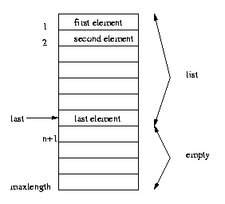
Array Implementation
Elements are stored in contiguous array positions

Slide 9
Array Application
Stores Elements of Same Data Type
Array Used for Maintaining multiple variable names using single name
Array Can be Used for Sorting Elements
Array Can Perform Matrix Operation
Array Can be Used in CPU Scheduling
Array Can be Used in Recursive Function

Slide 10
Array Implementation...
Requires an estimate of the maximum size of the list
waste space
printList and find: O(n)
findKth: O(k)
insert and delete: O(n)
e.g. insert at position 0 (making a new element)
requires first pushing the entire array down one spot to make room
e.g. delete at position 0
requires shifting all the elements in the list up one
On average, half of the lists needs to be moved for either operation

Slide 11
Example Implementation
Array-based implementation
Uses an iterator to move cursor
Has a fixed size

Slide 12
SPARSE Matrix
A matrix is a two-dimensional data object made of m rows and n columns, therefore having m X n values. When m=n, we call it a square matrix.
There may be a situation in which a matrix contains more number of ZERO values than NON-ZERO values. Such matrix is known as sparse matrix.
When a sparse matrix is represented with 2-dimensional array, we waste lot of space to represent that matrix.
For example, consider a matrix of size 100 X 100 containing only 10 non-zero elements.

Slide 13
Contd…
In this matrix, only 10 spaces are filled with non-zero values and remaining spaces of matrix are filled with zero.
totally we allocate 100 X 100 X 2 = 20000 bytes of space to store this integer matrix.
to access these 10 non-zero elements we have to make scanning for 10000 times.
If most of the elements in a matrix have the value 0, then the matrix is called spare matrix. Example For 3 X 3 Sparse Matrix: | 1 0 0 | | 0 0 0 | | 0 4 0 |

Slide 14
Sparse Matrix Representations
A sparse matrix can be represented by using TWO representations, those are as follows...
Triplet Representation
Linked Representation

Slide 15
Array Representation Of Sparse Matrix
Example For 3 X 3 Sparse Matrix: | 1 0 0 | | 0 0 0 | | 0 4 0 |
3-Tuple Representation Of Sparse Matrix: | 3 3 2 | | 0 0 1 | | 2 1 4 | Elements in the first row represents the number of rows, columns and non-zero values in sparse matrix. First Row - | 3 3 2 | 3 - rows 3 - columns 2 - non- zero values
Elements in the other rows gives information about the location and value of non-zero elements. | 0 0 1 | ( Second Row) - represents value 1 at 0th Row, 0th column | 2 1 4 | (Third Row) - represents value 4 at 2nd Row, 1st column

Slide 16
Array Declaration
Int a[10];
B=10;
Int c[b];
Innt [b+5];
2-D Array
Int a[4][5];

Slide 17
Dynamic array declaration
int size;
scanf("&d",&size);
int *p1 = (int*)malloc(sizeof(int)*size);
int p1[size];
for(i = 0; i < size; i++ )
{ scanf("%d",&p[i])
}
Or
for(i = 0; i < size; i++ )
{ scanf("%d",(p+i));
}

Slide 18
Array Implementation
for(i=0;i<m;i++)
{
for(j=0;j<n;j++)
{
printf("%d ",A[i][j]);
}
printf("\n");
}
for(i=0;i<m;i++)
{
for(j=0;j<n;j++)
{
if(A[i][j]!=0)
{
B[s][0]=A[i][j];
B[s][1]=i;
B[s][2]=j;
s++;} }
}

Slide 19
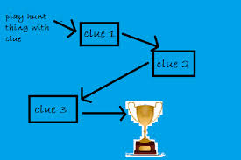
Linked List
Alternate approach to maintaining an array of elements
Rather than allocating one large group of elements, allocate elements as needed
Q: how do we know what is part of the array?
A: have the elements keep track of each other
use pointers to connect the elements together as a LIST of things

Slide 20

Linked List ADT
A linked list is a series of connected nodes, where each node is a data structure.
A linked list can grow or shrink in size as the program runs
Insertion and deletion of nodes is quicker with linked lists.

Slide 21
Dynamically Allocating Elements
Allocate elements one at a time as needed, have each element keep track of the next element
Result is referred to as linked list of elements, track next element with a pointer

Slide 22
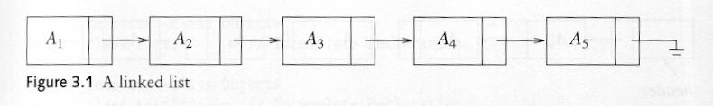
Pointer Implementation (Linked List)
Ensure that the list is not stored contiguously
use a linked list
a series of structures that are not necessarily adjacent in memory
Each node contains the element and a pointer to a structure containing its successor
the last cell’s next link points to NULL
Compared to the array implementation,
the pointer implementation uses only as much space as is needed for the elements currently on the list
but requires space for the pointers in each cell

Slide 23
Linked Lists
A
B
C
∅
Head
A linked list is a series of connected nodes
Each node contains at least
A piece of data (any type)
Pointer to the next node in the list
Head: pointer to the first node
The last node points to NULL
node
A
data
pointer

Slide 24
Linked Implementation...
Requires no estimate of the maximum size of the list
No wasted space
printList and find: O(n)
findKth: O(k)
insert and delete: O(1)
e.g. insert at position 0 (making a new element)
Insert does not require moving the other elements
e.g. delete at position 0
requires no shifting of elements
Insertion and deletion becomes easier, but finding the Kth element moves from O(1) to O(n)

Slide 25
Variations of Linked Lists
Doubly linked lists
Each node points to not only successor but the predecessor
There are two NULL: at the first and last nodes in the list
Advantage: given a node, it is easy to visit its predecessor. Convenient to traverse lists backwards
∅
A
B
C
∅
Head

Slide 26
Variations of Linked Lists
Circular linked lists
The last node points to the first node of the list
How do we know when we have finished traversing the list? (Tip: check if the pointer of the current node is equal to the head.)
A
B
C
Head

Slide 27
A Simple Linked List Class
Operations of List
IsEmpty: determine whether or not the list is empty
InsertNode: insert a new node at a particular position
FindNode: find a node with a given value
DeleteNode: delete a node with a given value
DisplayList: print all the nodes in the list

Slide 28
CREATION OF A NODE TO THE LIST
To append a node to a linked list means to add the node to the end of the list.
Begin Node Creation
Create a new node. Store data in the new node. If there are no nodes in the list Make the new node the first node. Else Traverse the List to Find the last node. Add the new node to the end of the list. End If.
End Node Creation

Slide 29
Creating the structure of a node in C program
struct Node
{
int data;
struct Node *next;
}*head = NULL;

Slide 30
Inserting a new node
Possible cases of InsertNode
Insert into an empty list
Insert in front
Insert at back
Insert in middle
But, in fact, only need to handle two cases
Insert as the first node (Case 1 and Case 2)
Insert in the middle or at the end of the list (Case 3 and Case 4)

Slide 31
Singly-linked lists
Here is a singly-linked list (SLL):
myList
a
b
c
d
Each node contains a value and a link to its successor (the last node has no successor)
The header points to the first node in the list (or contains the null link if the list is empty)

Slide 32
Inserting a node into a SLL
There are many ways you might want to insert a new node into a list:
As the new first element
As the new last element
Before a given node (specified by a reference)
After a given node
Before a given value
After a given value
All are possible, but differ in difficulty

Slide 33
Using a header node
The entry point into a linked list is called the head of the list.
It should be noted that head is not a separate node, but the reference to the first node.
If the list is empty then the head is a null reference.
head
one
two
NULL

Slide 34
Inserting At Beginning of the list
We can use the following steps to insert a new node at beginning of the single linked list...
Step 1: Create a newNode with given value.
Step 2: Check whether list is Empty (head == NULL)
Step 3: If it is Empty then, set newNode→next = NULL and head = newNode.
Step 4: If it is Not Empty then, set newNode→next = head and head = newNode.

Slide 35
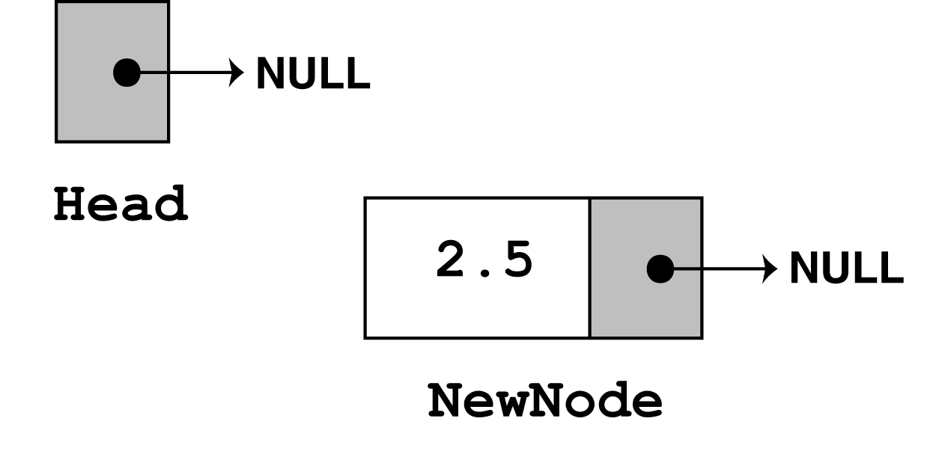
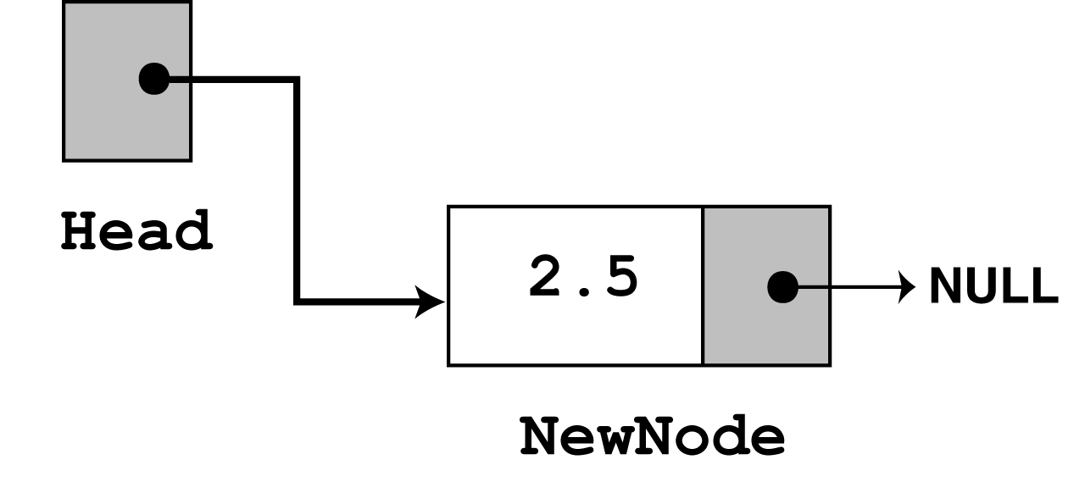
CREATING and INSERTING A NODE
Creating a new node
newNode = new ListNode; newNode->value = num;
If it’s the first node set it to point header
head=newNode; head->next = NULL;
If already elements are there in the list
newNode->next = head;
head=newNode;

Slide 36
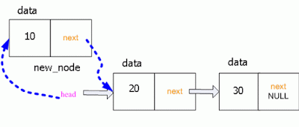
Example

Slide 37
Contd…
void insertAtBeginning(int value)
{
struct Node *newNode;
newNode = (struct Node*)malloc(sizeof(struct Node));
newNode->data = value;
if(head == NULL)
{
newNode->next = NULL;
head = newNode;
}
else
{
newNode->next = head;
head = newNode;
}
printf("\nOne node inserted!!!\n");
}

Slide 38
Inserting At End of the list
Step 1: Create a newNode with given value and newNode → next as NULL.
Step 2: Check whether list is Empty (head == NULL).
Step 3: If it is Empty then, set head = newNode.
Step 4: If it is Not Empty then, define a node pointer temp and initialize with head.
Step 5: Keep moving the temp to its next node until it reaches to the last node in the list (until temp → next is equal to NULL).
Step 6: Set temp → next = newNode.

Slide 39
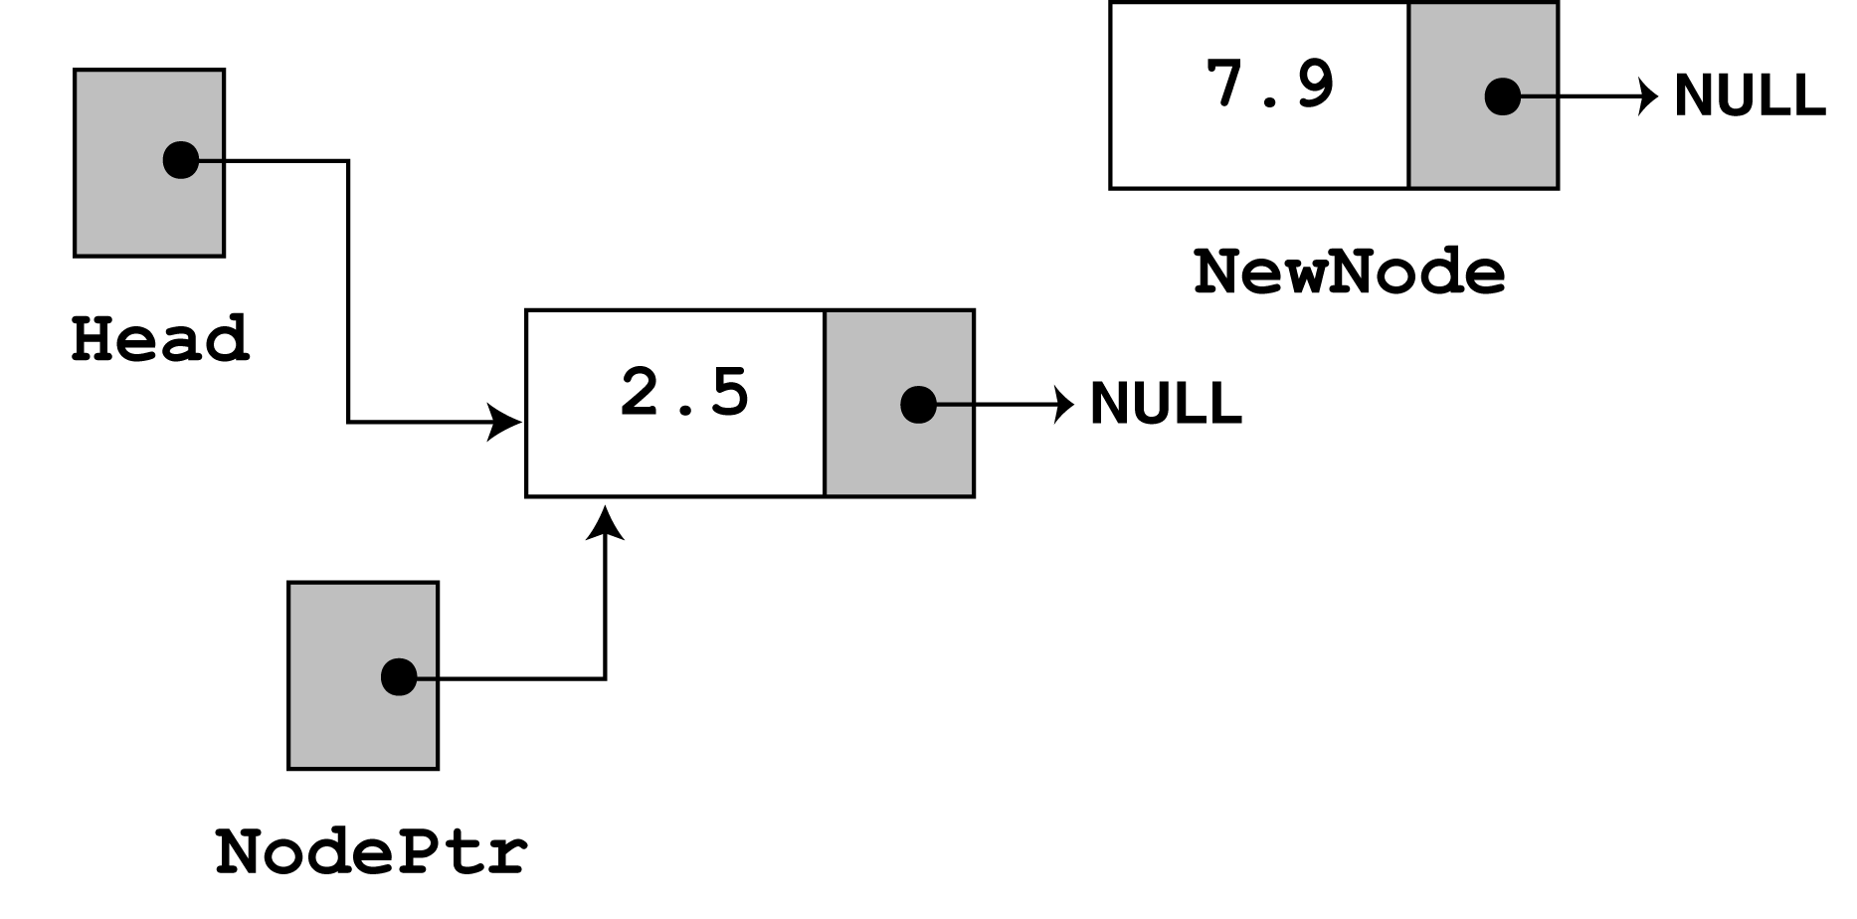
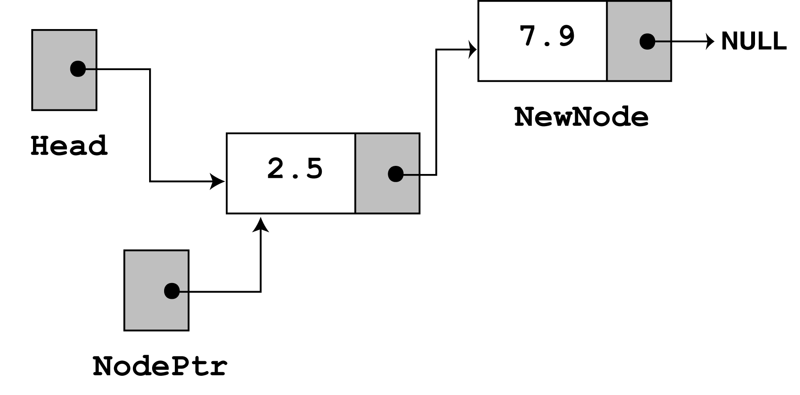
INSERTING A NEW NODE AT END
Use a Node Pointer to trace to the current position
Move the Node pointer to traverse till the end of the list

Slide 40
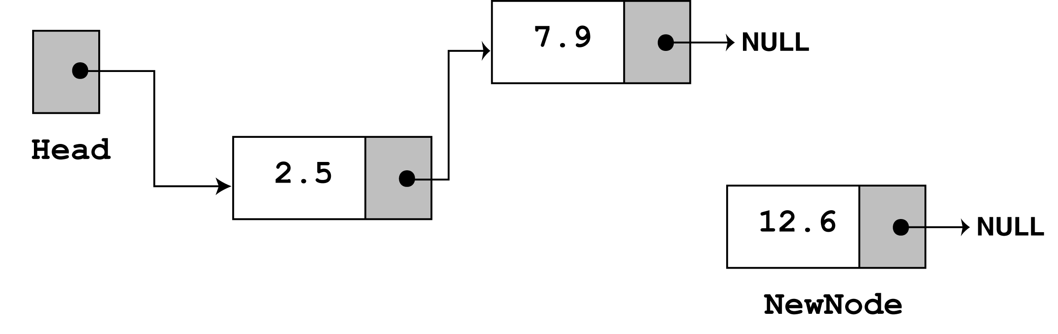
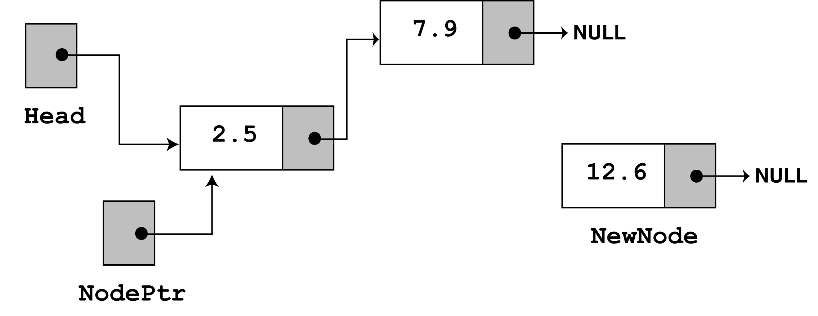
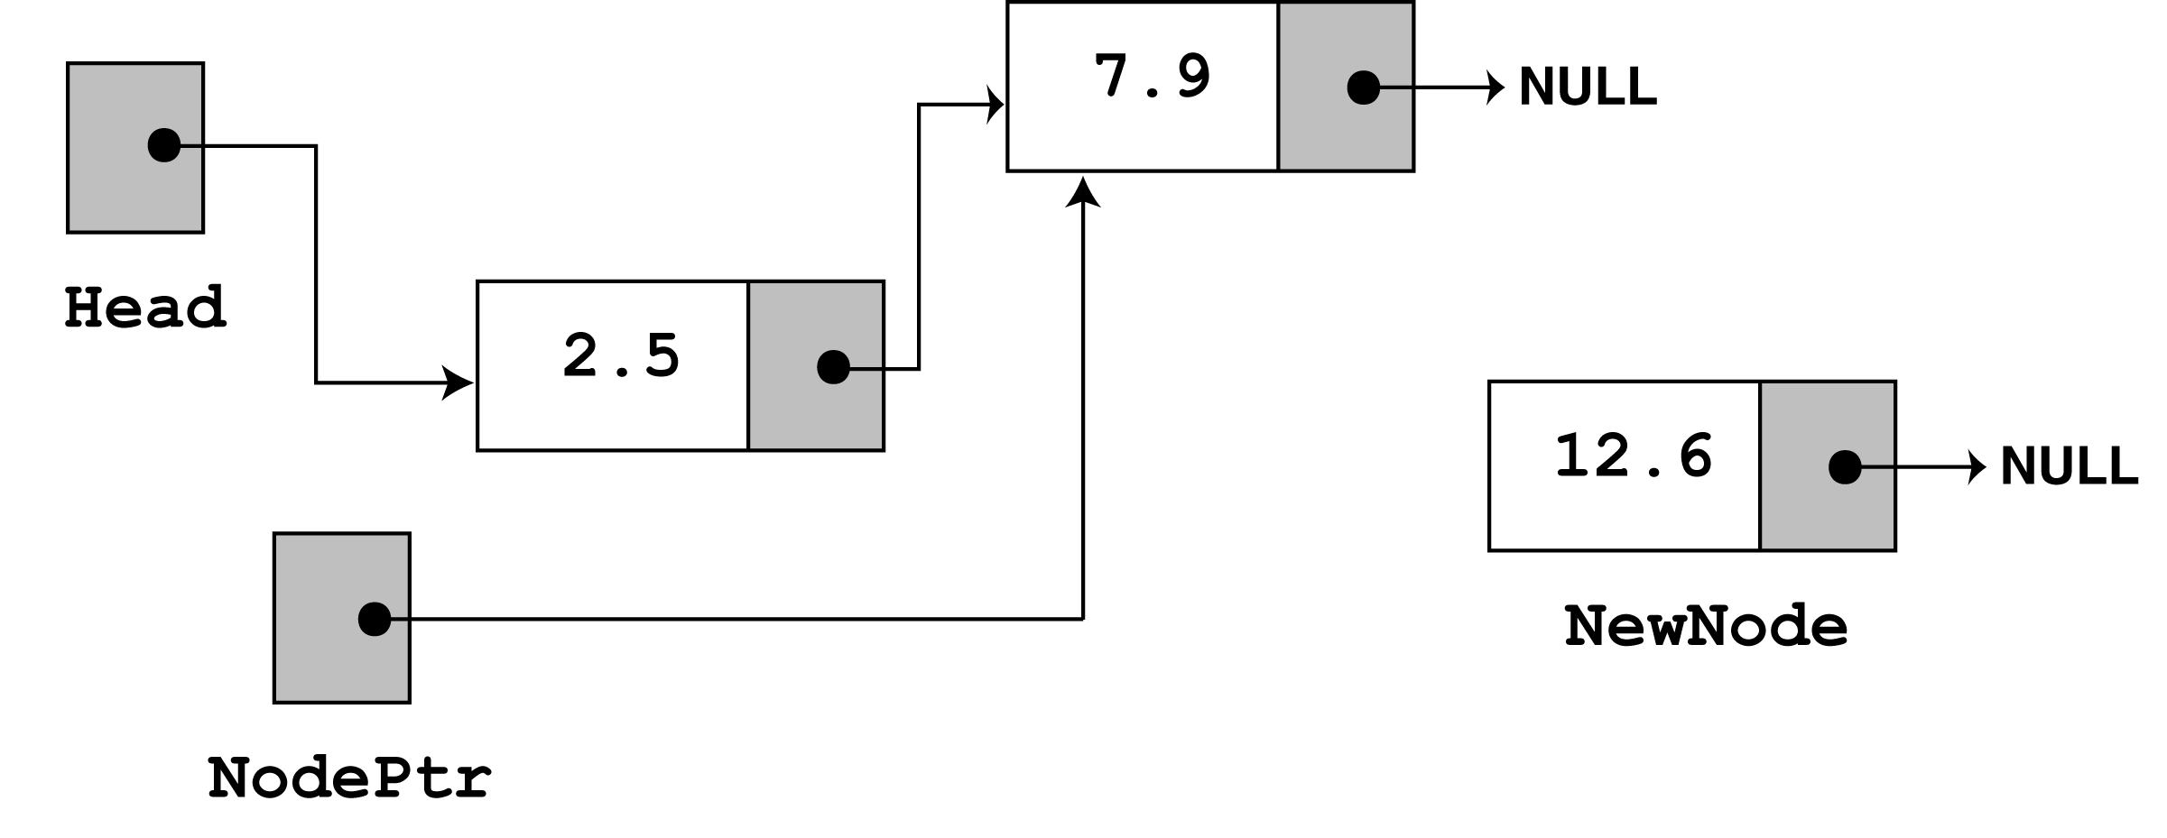
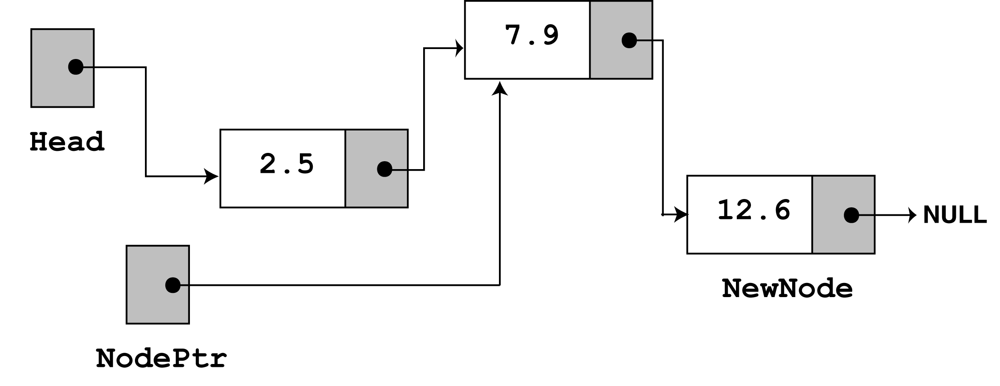
If the Node pointer does not points to NULL then
Move the Node pointer to the next node until it points to NULL
nodePtr=nodePtr->next;
When it reaches NULL append the newNode at the last
nodePtr ->next=newNode;
newNode->next=NULL;

Slide 41
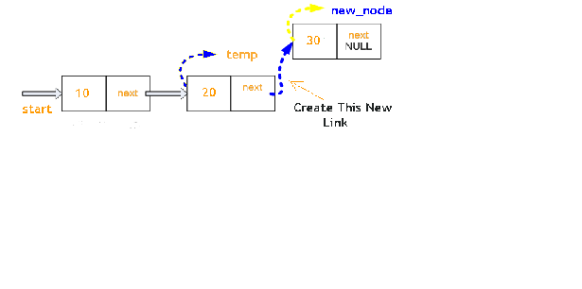
Example

Slide 42
Contd…..
void insertAtEnd(int value)
{
struct Node *newNode;
newNode = (struct Node*)malloc(sizeof(struct Node));
newNode->data = value;
newNode->next = NULL;
if(head == NULL)
head = newNode;
else
{
struct Node *temp = head;
while(temp->next != NULL)
temp = temp->next;
temp->next = newNode;
}
printf("\nOne node inserted!!!\n");
}

Slide 43
INSERTING A NEW NODE IN THE MIDDLE
Step 1: Create a newNode with given value.
Step 2: Check whether list is Empty (head == NULL)
Step 3: If it is Empty then, set newNode → next = NULL and head = newNode.
Step 4: If it is Not Empty then, define a node pointer temp and initialize with head.
Step 5: Keep moving the temp to its next node until it reaches to the node after which we want to insert the newNode (until temp → data is equal to location, here location is the node value after which we want to insert the newNode).
Step 6: Every time check whether temp is reached to last node or not. If it is reached to last node then display 'Given node is not found in the list!!! Insertion not possible!!!' and terminate the function. Otherwise move the temp to next node.
Step 7: Finally, Set 'newNode → next = temp → next' and 'temp → next = newNode'

Slide 44
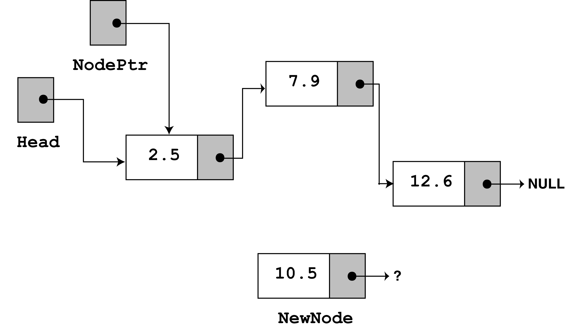
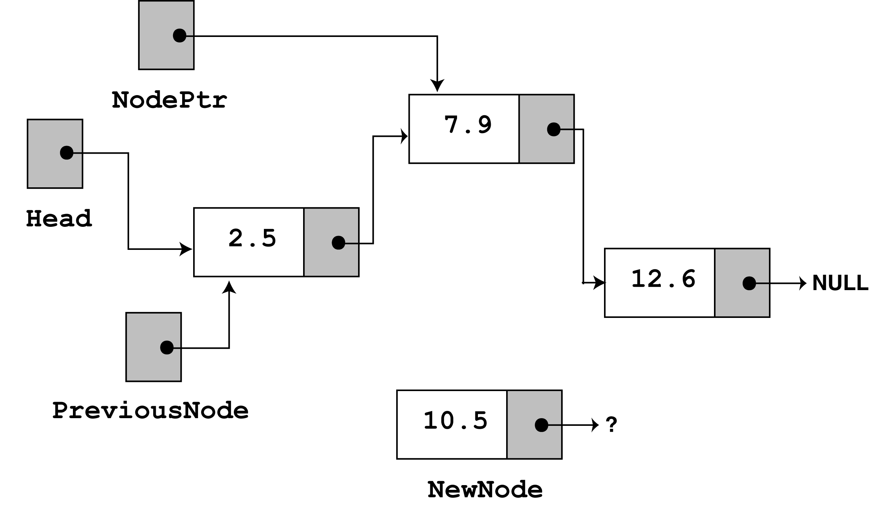
INSERTING A NEW NODE IN THE MIDDLE
Use a Node Pointer to trace to the current position
Also to store the value of the next address
Use a Previous Node Pointer to trace to the current position
previousNode=nodePtr;
nodePtr=nodePtr->next;

Slide 45
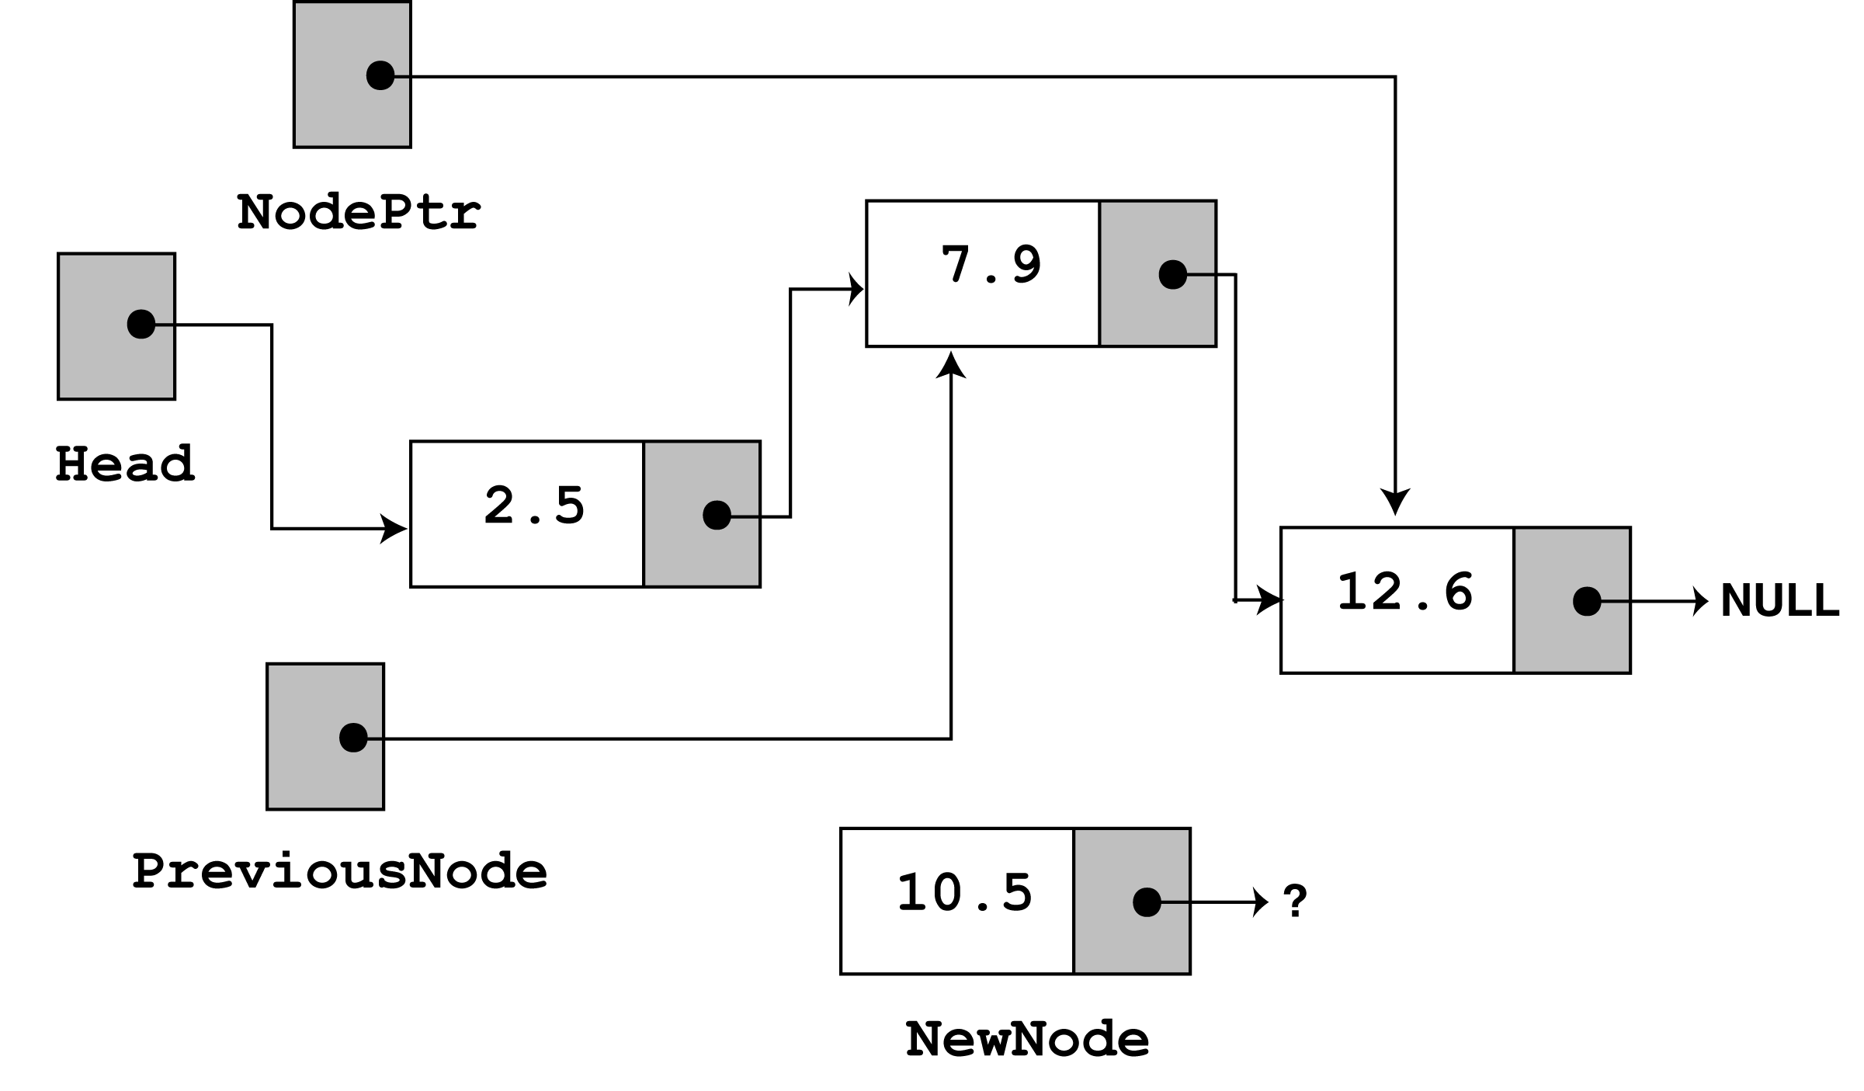
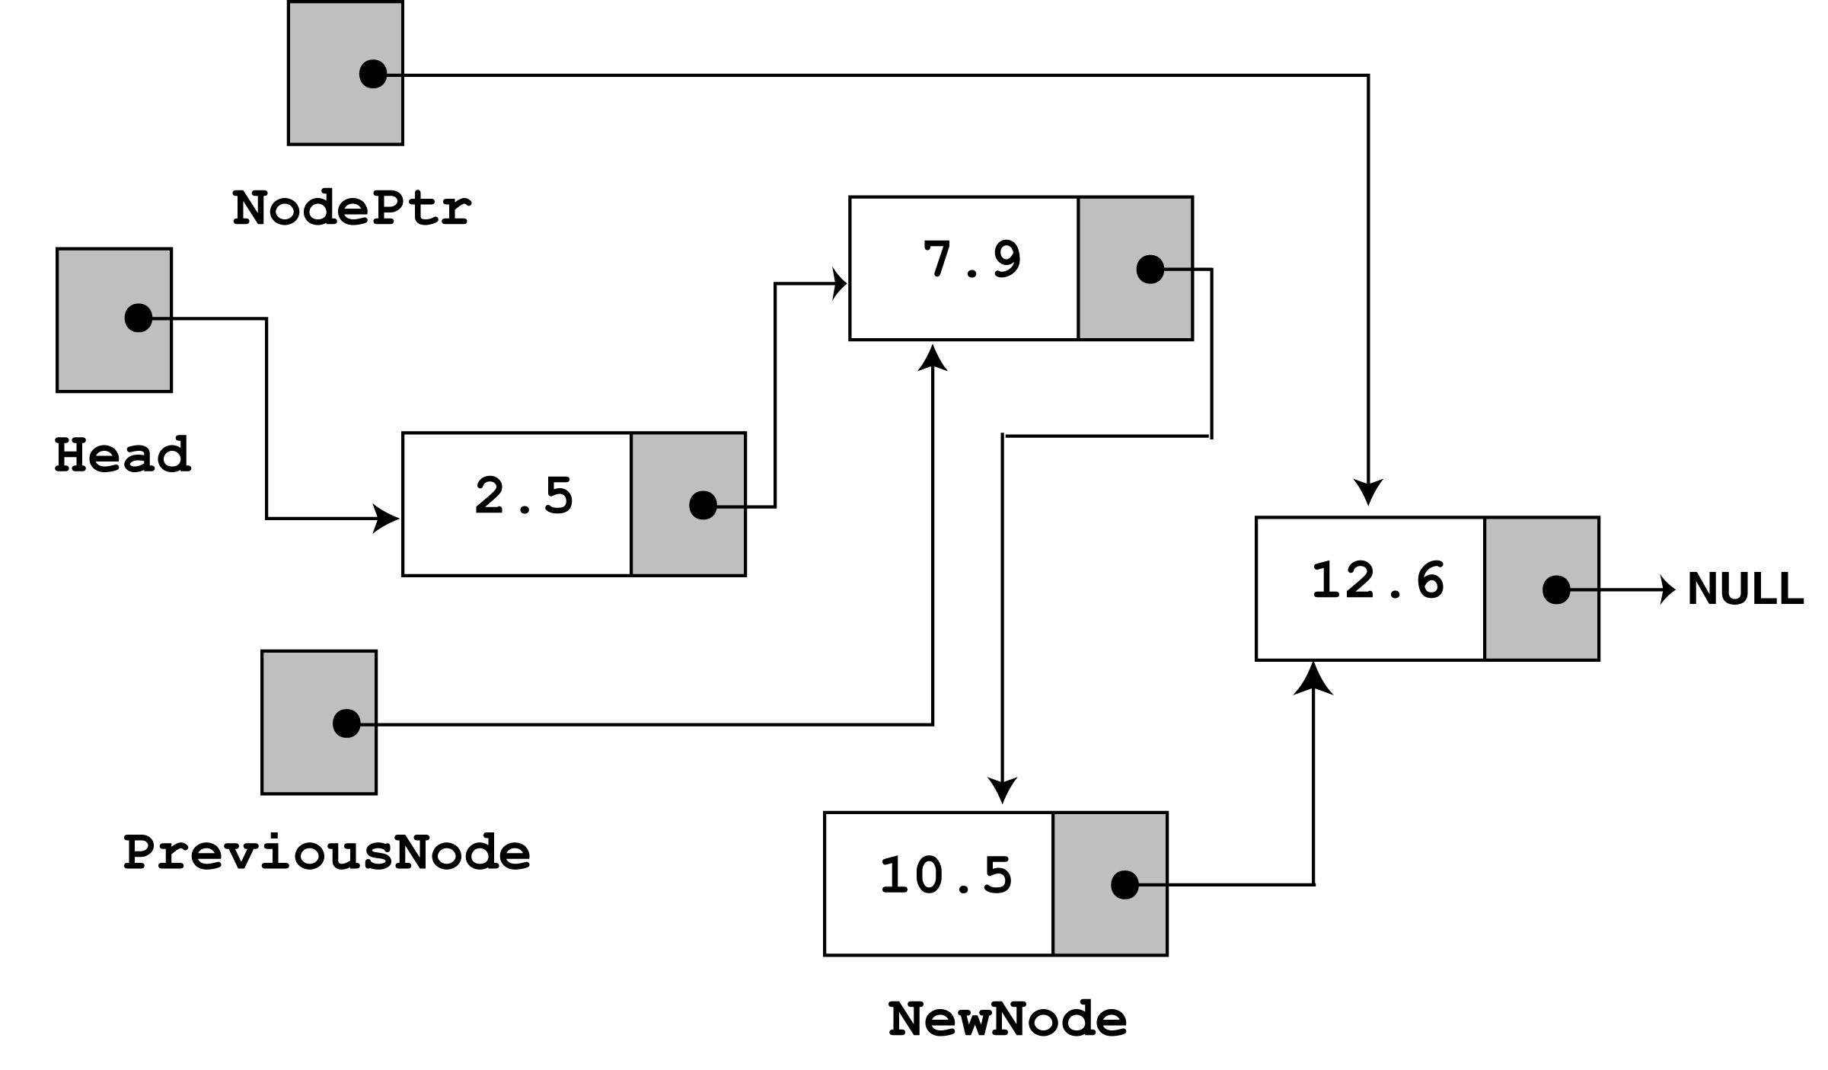
The New Node Pointer find the next node to insert the node
previousNode->next=newNode;
newnode->next=nodePtr;

Slide 46
Contd…
void insertBetween(int value, int loc)
{
struct Node *newNode,*prev_ptr,*cur_ptr;
newNode = (struct Node*)malloc(sizeof(struct Node));
newNode->data = value;
cur_ptr=head;
if(head == NULL)
{
newNode->next = NULL;
head = newNode;
}
else
{
for(i=1;i<loc;i++)
{
prev_ptr=cur_ptr;
cur_ptr = cur_ptr->next;
}
prev_ptr->next = newNode;
newNode->next = cur_ptr;
}
printf("\nOne node inserted!!!\n");
}

Slide 47
Deleting a node
int DeleteNode(double x)
Delete a node with the value equal to x from the list.
If such a node is found, return its position. Otherwise, return 0.
Steps
Find the desirable node (similar to FindNode)
Release the memory occupied by the found node
Set the pointer of the predecessor of the found node to the successor of the found node
Like InsertNode, there are two special cases
Delete first node
Delete the node in middle or at the end of the list

Slide 48
Deleting a node from a SLL
In order to delete a node from a SLL, you have to change the link in its predecessor
This is slightly tricky, because you can’t follow a pointer backwards
Deleting the first node in a list is a special case, because the node’s predecessor is the list header

Slide 49
Deleting from Beginning of the list
Step 1: Check whether list is Empty (head == NULL)
Step 2: If it is Empty then, display 'List is Empty!!! Deletion is not possible' and terminate the function.
Step 3: If it is Not Empty then, define a Node pointer 'temp' and initialize with head.
Step 4: Check whether list is having only one node (temp → next == NULL)
Step 5: If it is TRUE then set head = NULL and delete temp (Setting Empty list conditions)
Step 6: If it is FALSE then set head = temp → next, and delete temp.

Slide 50
Deleting an element from a SLL
• To delete the first element, change the link in the header
head
temp
one
two
three
NULL
Assign head to a temp. temp=head;
If the temp is not NULL,check whether the data to be deleted is head.
If true then delete the head node and make the next node as head.
head=temp->next;
free(temp);
head
two
three
NULL

Slide 51
Contd…
void removeBeginning()
{
if(head == NULL)
printf("\n\nList is Empty!!!");
else
{
struct Node *temp = head;
if(head->next == NULL)
{
head = NULL;
free(temp);
}
else
{
head = temp->next;
free(temp);
printf("\nOne node deleted!!!\n\n");
}
}
}

Slide 52
Deleting a Specific Node from the list
Step 1: Check whether list is Empty (head == NULL)
Step 2: If it is Empty then, display 'List is Empty!!! Deletion is not possible' and terminate the function.
Step 3: If it is Not Empty then, define two Node pointers 'temp1' and 'temp2' and initialize 'temp1' with head.
Step 4: Keep moving the temp1 until it reaches to the exact node to be deleted or to the last node. And every time set 'temp2 = temp1' before moving the 'temp1' to its next node.
Step 5: If it is reached to the last node then display 'Given node not found in the list! Deletion not possible!!!'. And terminate the function.
Step 6: If it is reached to the exact node which we want to delete, then check whether list is having only one node or not

Slide 53
Contd….
Step 7: If list has only one node and that is the node to be deleted, then set head = NULL and delete temp1 (free(temp1)).
Step 8: If list contains multiple nodes, then check whether temp1 is the first node in the list (temp1 == head).
Step 9: If temp1 is the first node then move the head to the next node (head = head → next) and delete temp1.
Step 10: If temp1 is not first node then check whether it is last node in the list (temp1 → next == NULL).
Step 11: If temp1 is last node then set temp2 → next = NULL and delete temp1 (free(temp1)).
Step 12: If temp1 is not first node and not last node then set temp2 → next = temp1 → next and delete temp1 (free(temp1)).

Slide 54
Deleting an element from a SLL
• To delete some other element, change the link in its predecessor
head
temp 1
(predecessor)
temp2
one
two
three
NULL
Use a Node Pointer to trace to the current position
Also to store the value of the next address
Use a Previous Node Pointer to trace to the current position
temp2=temp1;
temp1=temp1->next;
• If the deleted element is found then
temp2->next=temp1->next;
free( temp1);

Slide 55
Contd…
void removeSpecific(int delValue)
{
struct Node *temp1 = head, *temp2;
while(temp1->data != delValue)
{
if(temp1 -> next == NULL){
printf("\nGiven node not found in the list!!!");
}
temp2 = temp1;
temp1 = temp1 -> next;
}
temp2 -> next = temp1 -> next;
free(temp1);
printf("\nOne node deleted!!!\n\n");
}

Slide 56
Deleting from End of the list
Step 1: Check whether list is Empty (head == NULL)
Step 2: If it is Empty then, display 'List is Empty!!! Deletion is not possible' and terminate the function.
Step 3: If it is Not Empty then, define two Node pointers 'temp1' and 'temp2' and initialize 'temp1' with head.
Step 4: Check whether list has only one Node (temp1 → next == NULL)
Step 5: If it is TRUE. Then, set head = NULL and delete temp1. And terminate the function. (Setting Empty list condition)
Step 6: If it is FALSE. Then, set 'temp2 = temp1 ' and move temp1 to its next node. Repeat the same until it reaches to the last node in the list. (until temp1 → next == NULL)
Step 7: Finally, Set temp2 → next = NULL and delete temp1.

Slide 57
Contd…
void removeEnd()
{
if(head == NULL)
{
printf("\nList is Empty!!!\n");
}
else
{
struct Node *temp1 = head,*temp2;
if(head->next == NULL)
head = NULL;
else
{
while(temp1->next != NULL)
{
temp2 = temp1;
temp1 = temp1->next;
}
temp2->next = NULL;
}
free(temp1);
printf("\nOne node deleted!!!\n\n");}}

Slide 58
Displaying a Single Linked List
Step 1: Check whether list is Empty (head == NULL)
Step 2: If it is Empty then, display 'List is Empty!!!' and terminate the function.
Step 3: If it is Not Empty then, define a Node pointer 'temp' and initialize with head.
Step 4: Keep displaying temp → data with an arrow (--->) until temp reaches to the last node
Step 5: Finally display temp → data with arrow pointing to NULL (temp → data ---> NULL).

Slide 59
void display()
{
if(head == NULL)
{
printf("\nList is Empty\n");
}
else
{
struct Node *temp = head;
printf("\n\nList elements are - \n");
while(temp->next != NULL)
{
printf("%d --->",temp->data);
temp = temp->next;
}
printf("%d --->NULL",temp->data);
}
}

Slide 60
Doubly Linked Lists
Doubly linked lists
Each node points to not only successor but the predecessor
There are two NULL: at the first and last nodes in the list
Advantage: given a node, it is easy to visit its predecessor. Convenient to traverse lists backwards
∅
A
B
C
∅
Head

Slide 61
Doubly-linked lists
Here is a doubly-linked list (DLL):
myDLL
Previous pointer
Data
Next pointer
head
a
b
c
NULL
last
Each node contains a value, a link to its successor (if any), and a link to its predecessor (if any)
The header points to the first node in the list and to the last node in the list (or contains null links if the list is empty)

Slide 62
Node data
info: the user's data
next, previous: the address of the next and previous node in the list
.back
.info
.next
previous
info
next

Slide 63
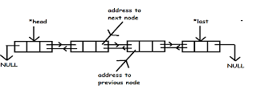
DLL

Slide 64
Advantages and Disadvantages of Doubly Linked List
Advantages: 1. We can traverse in both directions i.e. from starting to end and as well as from end to starting. 2. It is easy to reverse the linked list. 3. If we are at a node, then we can go to any node. But in linear linked list, it is not possible to reach the previous node. Disadvantages: 1. It requires more space per space per node because one extra field is required for pointer to previous node. 2. Insertion and deletion take more time than linear linked list because more pointer operations are required than linear linked list.

Slide 65
Node Creation
void create()
{
int data;
temp =(struct node *)malloc(sizeof(struct node));
temp->prev = NULL;
temp->next = NULL;
printf("\n Enter value to node : ");
scanf("%d", &data);
temp->n = data;
count++;
}

Slide 66
Insert at beginning
void insert_begning(int value)
{
struct node *newNode,*temp;
newNode=(struct node *)malloc(sizeof(struct node));
newNode->data=value;
if(head==NULL)
{
head=newNode;
head->previous=NULL;
head->next=NULL;
last=head;
}
else
{
temp=newNode;
temp->previous=NULL;
temp->next=head;
head->previous=temp;
head=temp;
} }

Slide 67
Insert at End
void insert_end(int value) {
struct node *newNode,*last,*next, *previous;
newNode=(struct node *)malloc(sizeof(struct node));
newNode->data=value; if(head==NULL)
{ head=newNode;
head->previous=NULL; head->next=NULL;
last=head;
}
else
{
last=head;
While (last->next!=NULL)
{
last=last->next;
}
last->next=newNode;
newNode->previous=last;
newNode->next=NULL;
last=newNode;
}
}

Slide 68
INSERT IN THE MIDDLE
int insert_after(int value, int loc)
{
struct node *temp,*newNode,*cur_ptr,
prev_ptr, *next,*previous;
newNode=(struct node *)malloc(sizeof(struct node));
newNode->data=value;
cur_ptr=head;
if(head==NULL)
{
head=newNode;
head->previous=NULL;
head->next=NULL;
}
else
{
for(i=1;i<loc;i++)
{
prev_ptr=cur_ptr;
cur_ptr = cur_ptr->next;
}
prev_ptr->next = newNode;
newNode->previous = prev_ptr;
newNode->next = cur_ptr;
cur_ptr->previous=newNode;
}
last=head;
while(last->next!=NULL)
{
last=last->next;
}
}

Slide 69
Delete at end
int delete_from_end()
{
struct node *temp;
temp=last;
if(temp->previous==NULL)
{
free(temp);
head=NULL;
last=NULL;
return 0;
}
printf("\nData deleted from list is %d \n",last->data);
last=temp->previous;
last->next=NULL;
free(temp);
return 0;
}

Slide 70
DELETE FROM MIDDLE
int delete_from_middle(int value)
{
struct node *temp,*var,*t, *temp1; temp=head; while(temp!=NULL)
{
if(temp->data == value)
{
if(temp->previous==NULL) {
free(temp);
head=NULL; last=NULL;
return 0;
}
else
{
var->next=temp1;
temp1->previous=var; free(temp);
return 0;
} }
else {
var=temp;
temp=temp->next; temp1=temp->next;
} }
printf("data deleted from list is %d",value);
}

Slide 71
DLLs compared to SLLs
Advantages:
Can be traversed in either direction
Some operations, such as deletion and inserting before a node, become easier
Disadvantages:
Requires more space
List manipulations are slower (because more links must be changed)
Greater chance of having bugs (because more links must be manipulated)

Slide 72
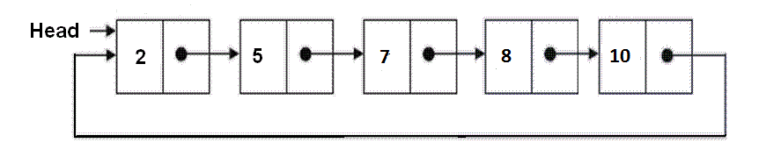
Circular Linked List
Circular linked list is a linked list where all nodes are connected to form a circle.
There is no NULL at the end.
A circular linked list can be a singly circular linked list or doubly circular linked list.

Slide 73
Advantages of Circular Linked Lists
Any node can be a starting point. We can traverse the whole list by starting from any point. We just need to stop when the first visited node is visited again.
Useful for implementation of queue.
For example, when multiple applications are running on a PC

Slide 74
OPERATIONS ON CIRCULARLY LINKED LIST Circular linked list - Creation
head = new;
new->next=head;
Circular linked list – Insertion ( only head node is available)
temp=head;
temp->next = new;
new -> next = head;

Slide 75
Circular linked list – Insertion(More nodes)
while( temp->next !=head)
{
temp=temp->next;
}
temp->next=new;
new->next=head;

Slide 76
Insertion at first
new->next = head
head =new;
temp->next= head;
Insertion at middle
n1->next = new;
new->next = n2;
n2->next = head;
Insertion at last
n2->next=new;
new->next = head;

Slide 77
Array versus Linked Lists
Linked lists are more complex to code and manage than arrays, but they have some distinct advantages.
Dynamic: a linked list can easily grow and shrink in size.
We don’t need to know how many nodes will be in the list. They are created in memory as needed.
In contrast, the size of a C++ array is fixed at compilation time.
Easy and fast insertions and deletions
To insert or delete an element in an array, we need to copy to temporary variables to make room for new elements or close the gap caused by deleted elements.
With a linked list, no need to move other nodes. Only need to reset some pointers.

Slide 78
Josephus Problem using Linked List
Josephus Problem talks about a problem where there are people standing in a circle waiting to be executed.
The counting out begins at some point in the circle and proceeds around the circle in a fixed direction.
In each step, a certain number of people are skipped and the next person is executed.
The elimination proceeds around the circle, until only the last person remains, who is given freedom.

Slide 79
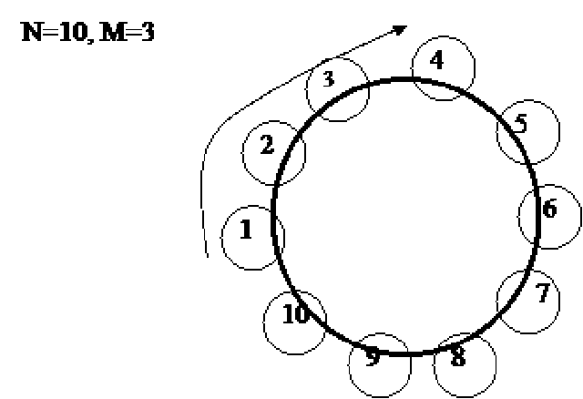
Example

Slide 80
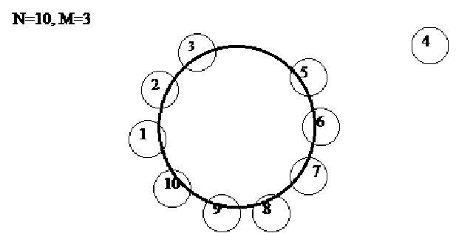
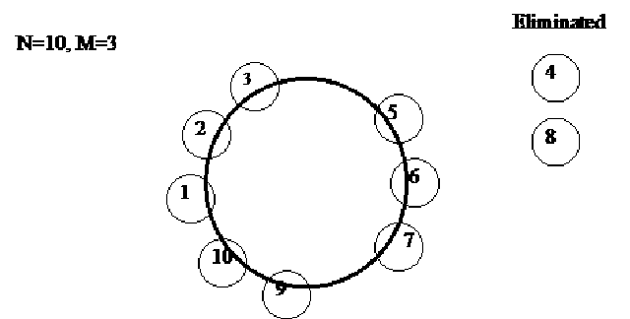

Slide 81
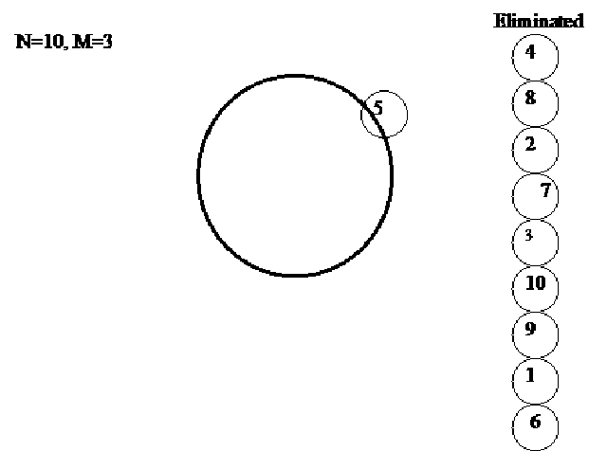

Slide 82
Josephus Problem - Snippet
int josephus(int m,node *head)
{
node *f;
int c=1;
while(head->next!=head)
{
c=1;
while(c!=m)
{
f=head;
head=head->next;
c++;
}
f->next=head->next;
printf("%d->",head->data); //sequence in which nodes getting deleted
head=f->next;
}
printf("\n");
printf("Winner is:%d\n",head->data);
return;
}

Slide 83
Array versus Linked Lists
Linked lists are more complex to code and manage than arrays, but they have some distinct advantages.
Dynamic: a linked list can easily grow and shrink in size.
We don’t need to know how many nodes will be in the list. They are created in memory as needed.
In contrast, the size of a C++ array is fixed at compilation time.
Easy and fast insertions and deletions
To insert or delete an element in an array, we need to copy to temporary variables to make room for new elements or close the gap caused by deleted elements.
With a linked list, no need to move other nodes. Only need to reset some pointers.

Slide 84
Polynomials
Representing Polynomials As Singly Linked Lists
The manipulation of symbolic polynomials, has a classic example of list processing.
In general, we want to represent the polynomial:
Where the a_{i} are nonzero coefficients and the e_{i} are nonnegative integer exponents such that
e_{m-1} ＞ e_{m-2} ＞ … ＞ e₁ ＞ e₀ ≧ 0 .
We will represent each term as a node containing coefficient and exponent fields, as well as a pointer to the next term.

Slide 85
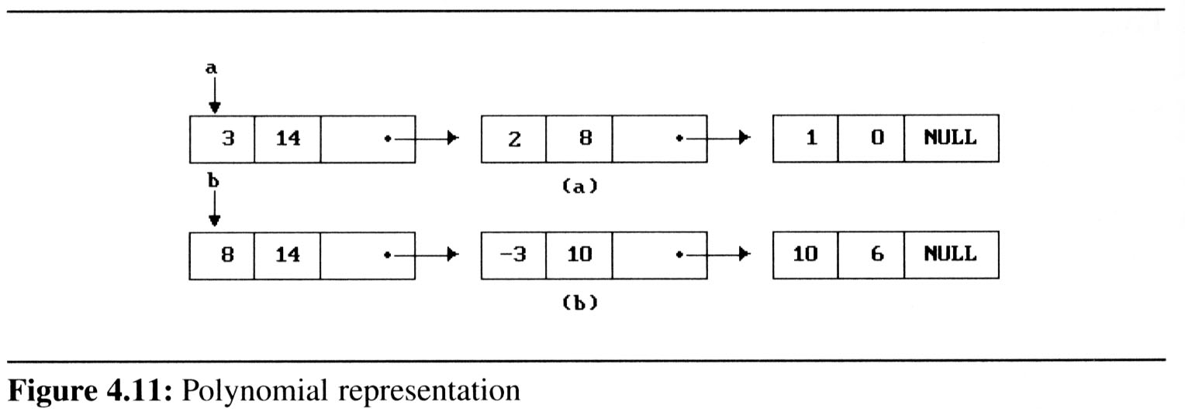
Polynomials
Assuming that the coefficients are integers, the type declarations are:
struct link{
int coeff;
int pow;
struct link *next;
};
Draw poly_nodes as:
coef | expon | link

Slide 86
Polynomials
Adding Polynomials
To add two polynomials,we examine their terms starting at the nodes pointed to by a and b.
If the exponents of the two terms are equal
add the two coefficients
create a new term for the result.
If the exponent of the current term in a is less than b
create a duplicate term of b
attach this term to the result, called d
advance the pointer to the next term in b.
We take a similar action on a if a->expon > b->expon.
Figure 4.12 generating the first three term of d = a+b (next page)

Slide 87
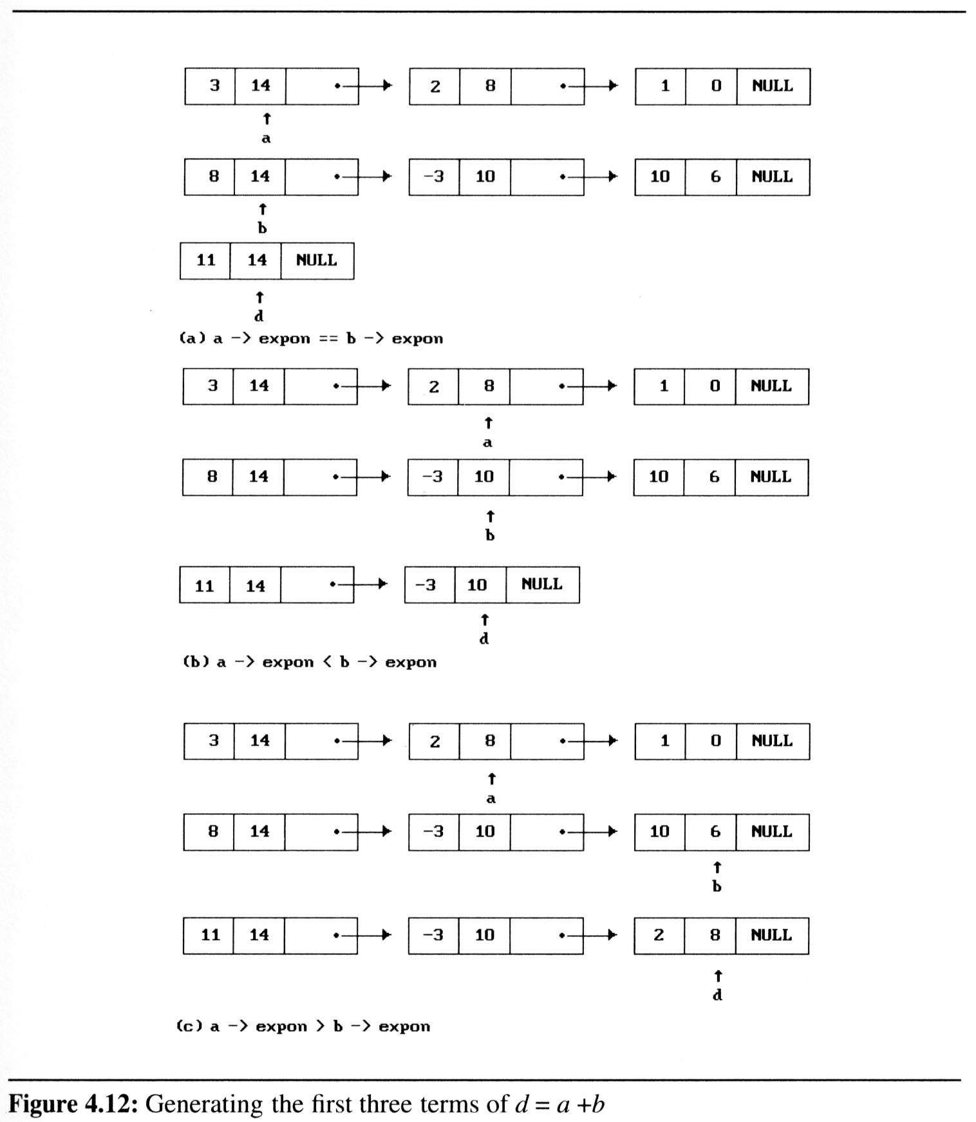
Polynomials

Slide 88
Polynomial - Creation
void create(struct link *node)
{
char ch;
do
{
printf("\n enter coeff:");
scanf("%d",&node->coeff);
printf("\n enter power:");
scanf("%d",&node->pow);
node=(struct link*)malloc(sizeof(struct link));
node->next=NULL;
printf("\n continue(y/n):");
ch=getch();
}
while(ch=='y' || ch=='Y');
}

Slide 89
Polynomial - Display
void show(struct link *node)
{
while(node->next!=NULL)
{
printf("%dx^%d",node->coeff,node->pow);
node=node->next;
if(node->next!=NULL)
printf("+");
}
}

Slide 90
Polynomial Add
poly2=poly2->next;
}
else
{
poly->pow=poly1->pow;
poly->coeff=poly1->coeff+poly2->coeff;
poly1=poly1->next;
poly2=poly2->next;
}
poly->next=(struct link *)malloc(sizeof(struct link));
poly=poly->next;
poly->next=NULL;
}
void polyadd(struct link *poly1,struct link *poly2,struct link *poly)
{
while(poly1->next && poly2->next)
{
if(poly1->pow>poly2->pow)
{
poly->pow=poly1->pow;
poly->coeff=poly1->coeff;
poly1=poly1->next;
}
else if(poly1->pow<poly2->pow)
{
poly->pow=poly2->pow;
poly->coeff=poly2->coeff;

Slide 91
Contd…
while(poly1->next || poly2->next)
{
if(poly1->next)
{
poly->pow=poly1->pow;
poly->coeff=poly1->coeff;
poly1=poly1->next;
}
if(poly2->next)
{
poly->pow=poly2->pow;
poly->coeff=poly2->coeff;
poly2=poly2->next;
}
poly->next=(struct link *)malloc(sizeof(struct link));
poly=poly->next;
poly->next=NULL;
}
}

Slide 92
THANK YOU

